Slide 1
Memristor in Learning Neural Networks
Shaodi Wang
Parts of slides from Elham Zamanidoost and Ligang Gao

Slide 2
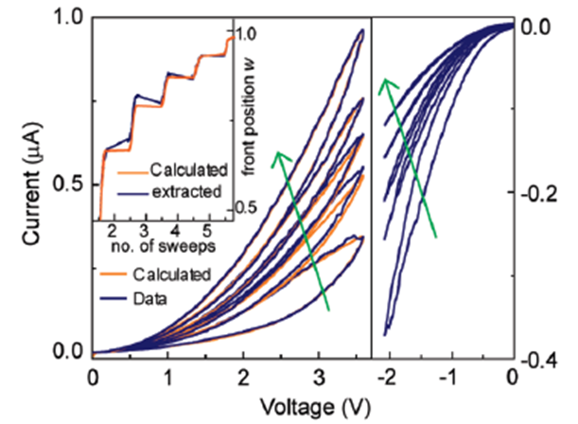
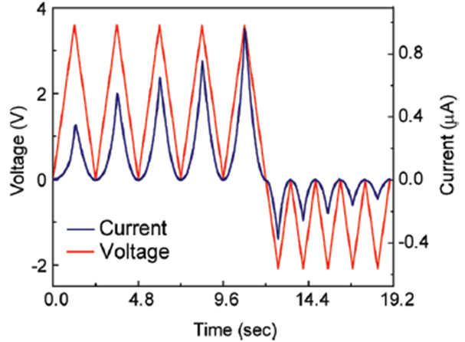
Characteristics
+
+
+
-
Ag
Ag
Ag
Ag
Pt
Pt
Pt
Pt
-
-
-
+

Slide 3
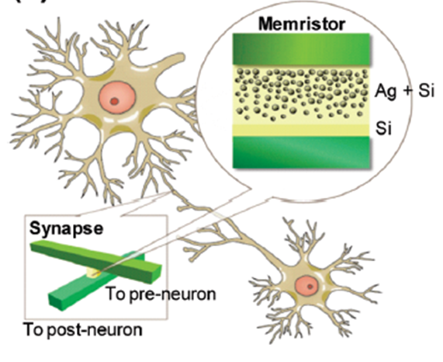
Neural Network

Slide 4
Learning in Neural Network
Supervised Learning
- Training set contains input and output
*Feed-forward network
*Recurrent network
Unsupervised Learning
-Training set contains input only
*self-organizing network

Slide 5
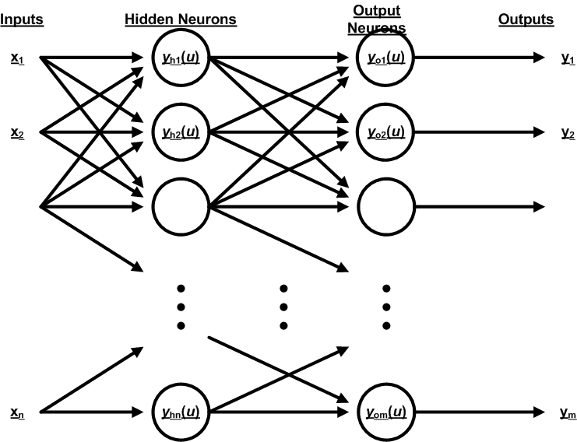
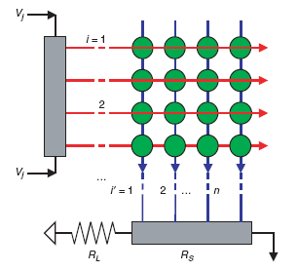
Multi Layer Perceptron
Hidden layer(s) perform classification of features
Sigmoid activation function
Back Propagation Learning:
Apply gradient decent over the entire network
As before, we have:
For every output neuron:
For every hidden neuron:

Slide 6
Gradient Descent
Define cost function as sum of errors over entire training set, and errors as:
Now train the network in order to minimize the cost. This means that we need to minimize the error. Hence, we need a continuous activation function to calculate the derivative.
Sigmoid activation function:
*Gradient Descent Learning
where

Slide 7
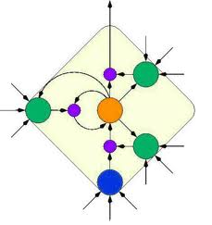
Recurrent Network
Characteristics:
- Nodes connect back to other nodes or themselves
- Information flow is bidirectional
Fully recurrent network: there is a pair of directed connections between every pair of neurons in the network

Slide 8

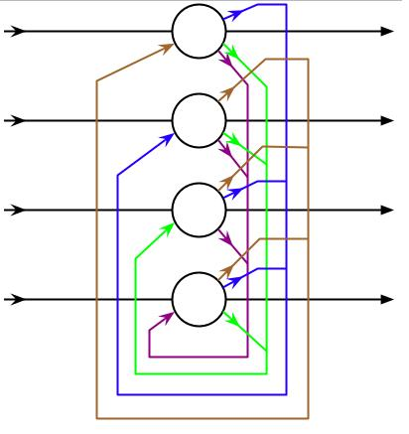
Hopfield Network
Characteristics:
- A RNN in which all connections are symmetric
- Binary threshold activation function (CAM)
- No unit has a connection with itself and W_{i,j} =W_{j,i} (symmetric)
- symmetric weights guarantee that the energy function decreases monotonically
Hebbian learning: Increase weight between two nodes if both have same activity, otherwise decrease.
Synchronous training: the outputs for all the nodes are
calculated before applied to the other nodes
Asynchronous training: randomly choose a node and
calculate its output

Slide 9
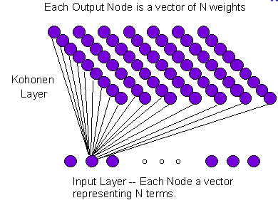
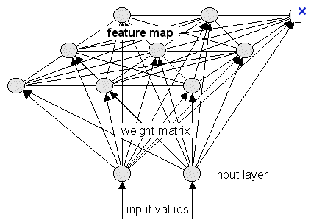
Self Organized Map
The purpose of SOM is to map a multidimensional input space onto a topology preserving map of neurons
  Preserve a topological so that neighboring neurons respond to « similar »input patterns
  The topological structure is often a 2 or 3 dimensional space
Each neuron is assigned a weight vector with the same dimensionality of the input space
Input patterns are compared to each weight vector and the closest wins (Euclidean Distance)

Slide 10
Thanks

