Slide 1
Magnetoelectric Random Access Memory (MeRAM)
Shaodi Wang
NanoCAD Group, UCLA

Slide 2
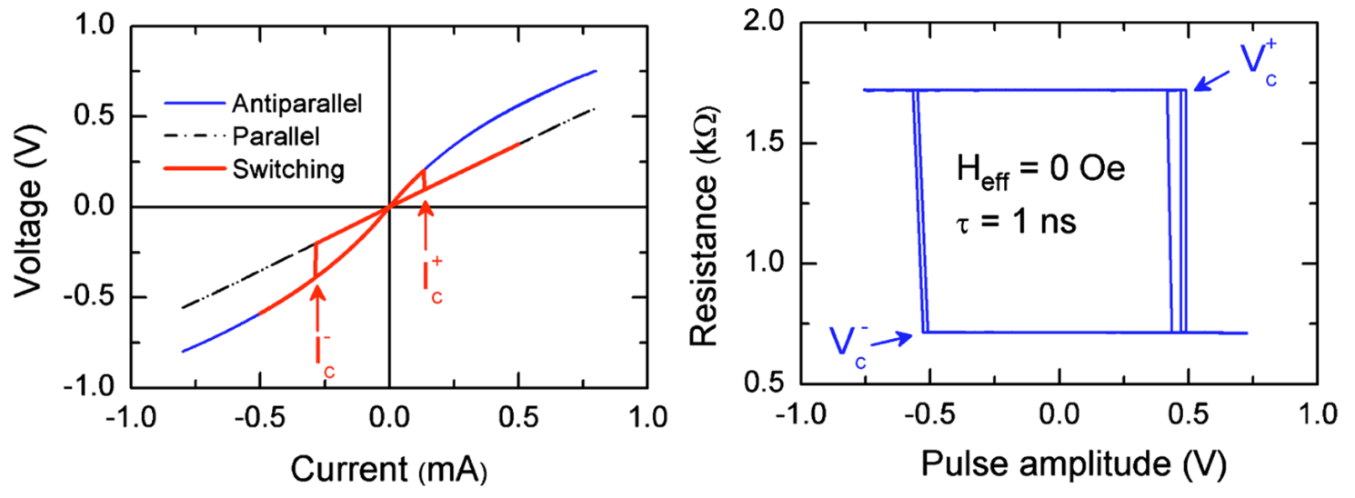
STT Characteristics
Fixed
MgO
Free
Tunneling Magnetoresistance Ratio:
  TMR = (R_{AP} – R_{P})/ R_{P} = 100 – 200%
Resistance around 1kΩ
Read/Write current : 0.x mA
  Read current must be smaller than write current
Energy consumption mainly comes from leakage current during read/write

Slide 3
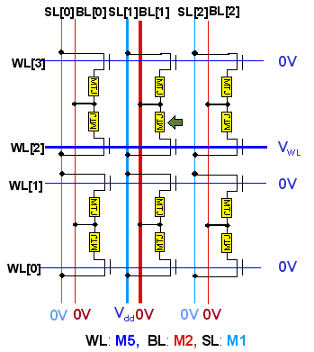
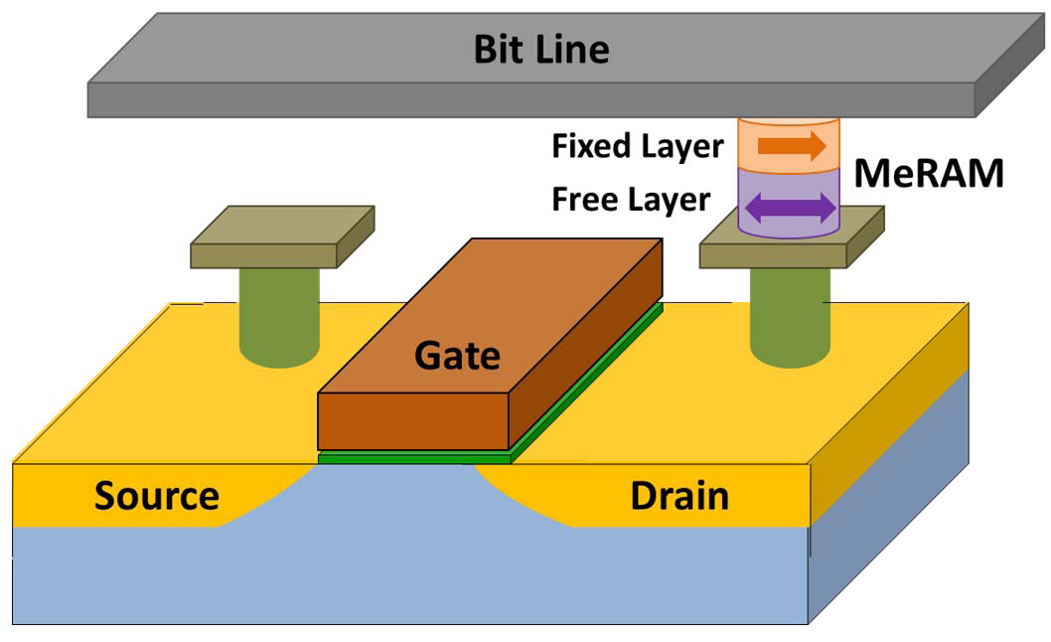
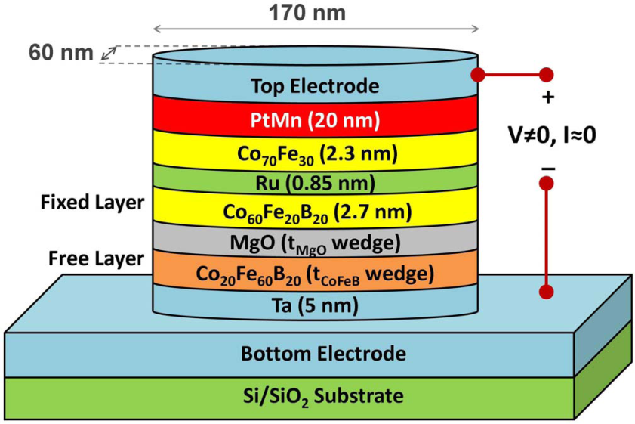
MeRAM Structure
J. G. Alzate et. al., IEDM, 2012
C.J. Lin et. al., IEDM, 2009

Slide 4
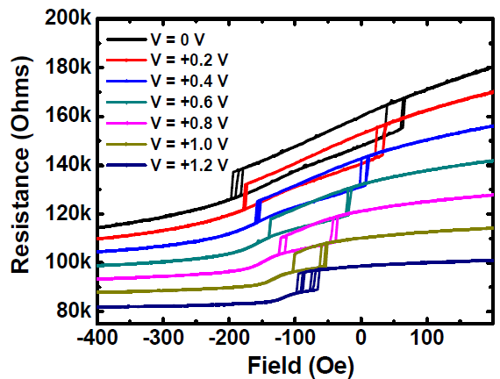
VCMA-Induced Switching
Coercivity
-The intensity of the applied magnetic field required to reduce the saturated magnetization of that material to zero.
Voltage Controlled Magnetic Anisotropy (VCMA)
-The coercivity can be reduced from ~ 120 Oe at equilibrium to ~ 10-20 Oe by applying voltages ~ 1 V due to the VCMA effect
J. G. Alzate et. al., IEDM, 2012

Slide 5
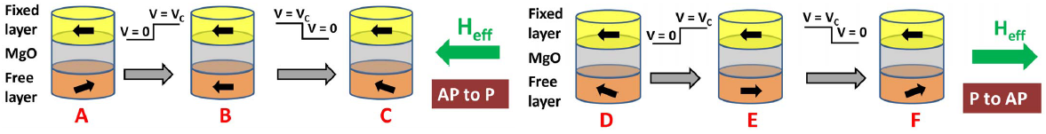
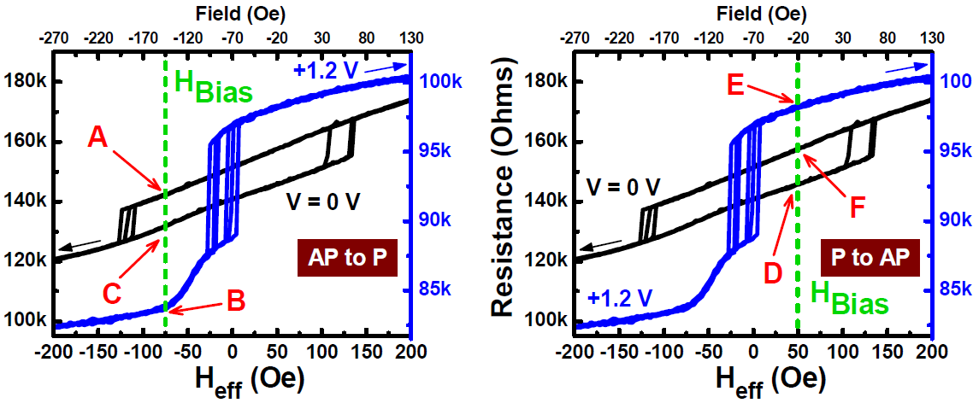
Switching
J. G. Alzate et. al., IEDM, 2012

Slide 6
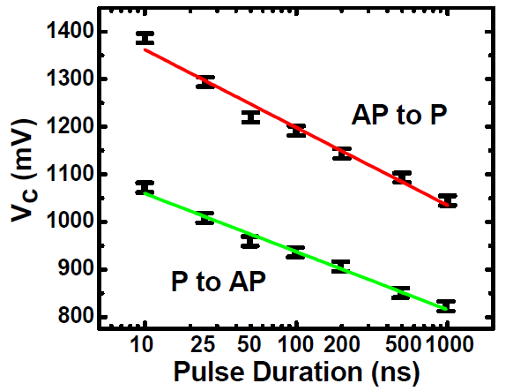
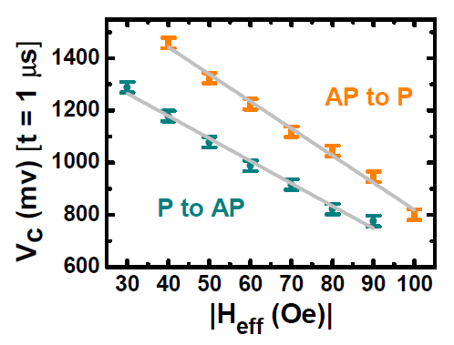
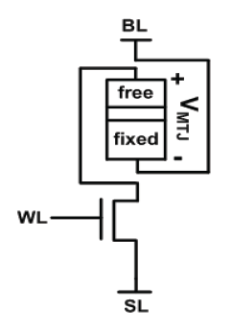
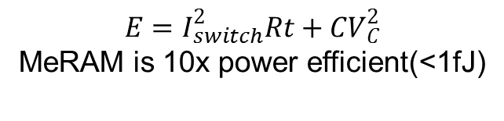
Switching Control
$$E=I_{switch}^{2}Rt+CV_{C}^{2}$$
MeRAM is 10x power efficient(<1fJ)
I_{switch}=V/R_{inter}

Slide 7
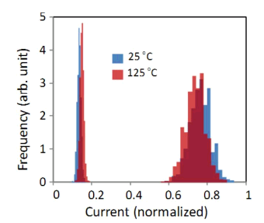
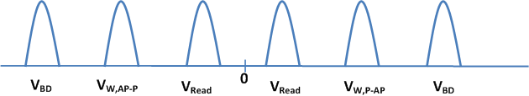
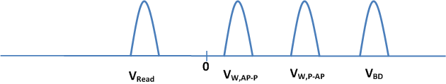
Variation Impact
Variability:
  Non-uniformity in fabrication of MTJ devices results in variances in read and write processes
12σ
12σ
12σ
12σ
STT RAM
12σ
12σ
MeRAM

Slide 8
Thanks

